Slide 1
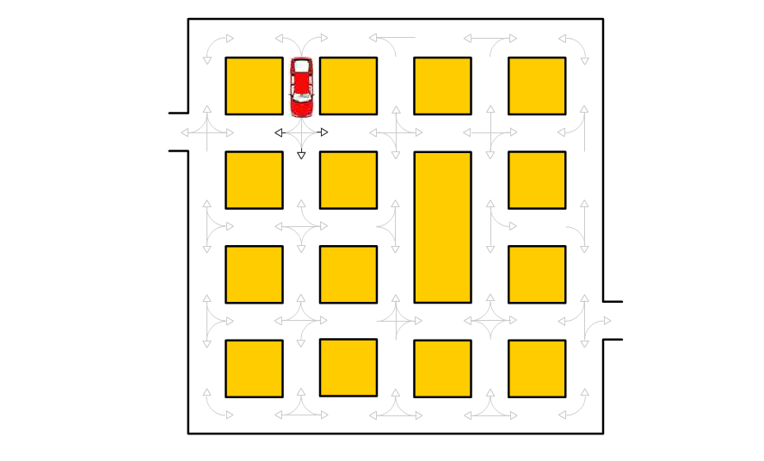
Solve this if U R Genius

